Slide 1
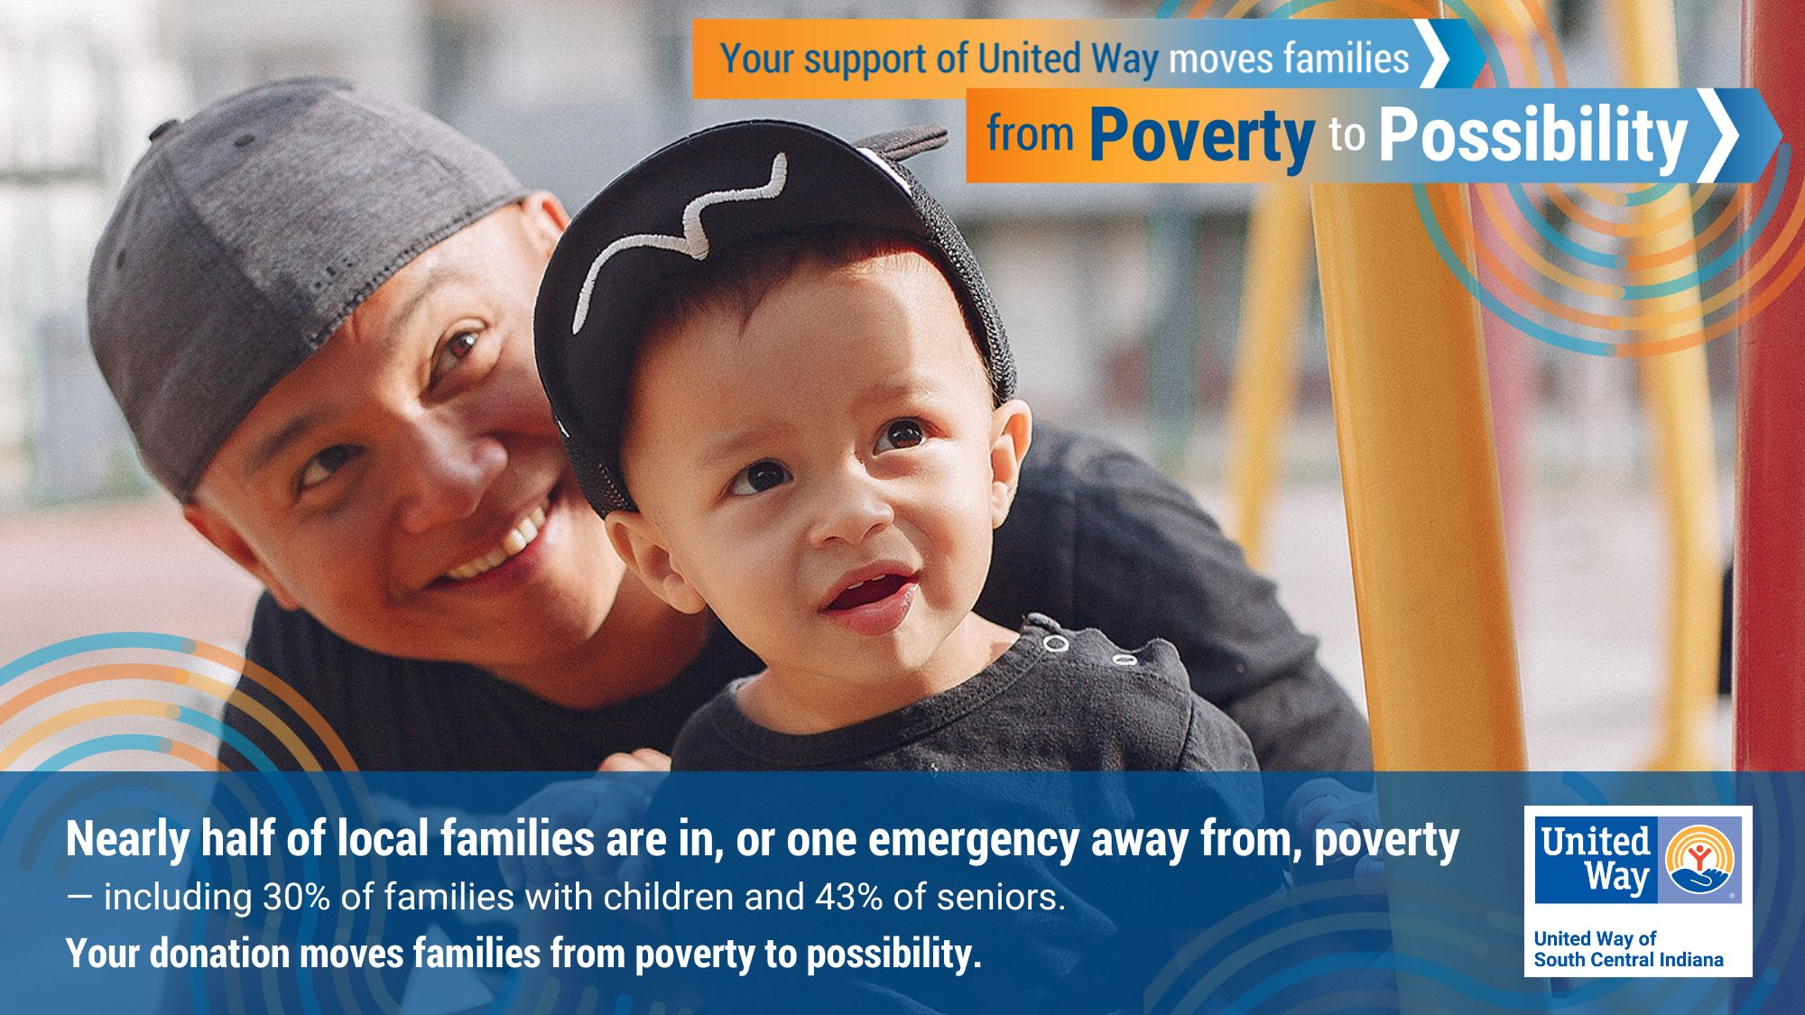

Slide 2
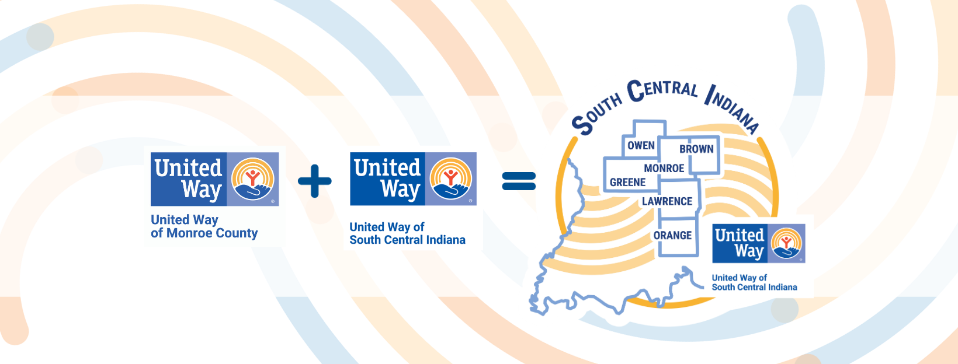

Slide 3
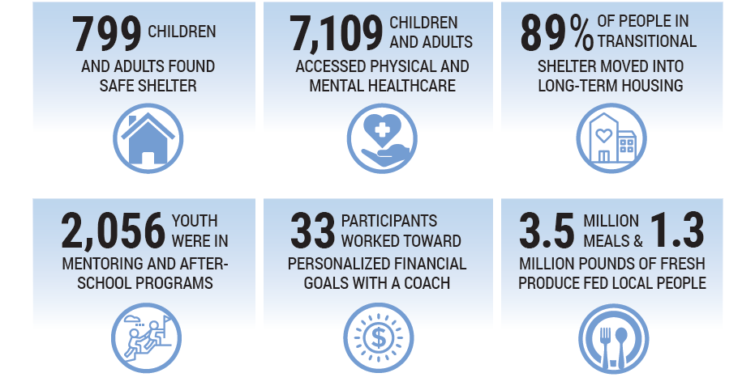
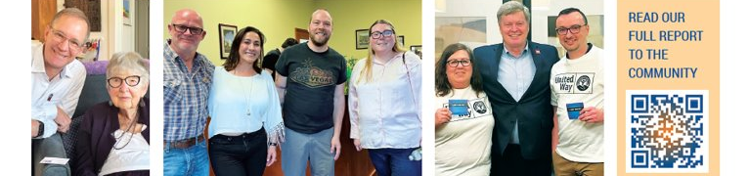

Slide 4
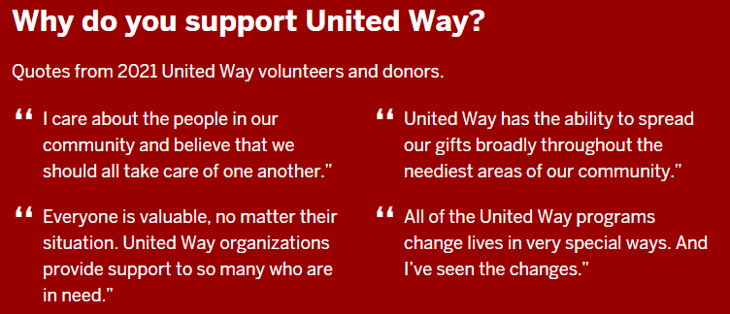
IU United Way Campaign
In 2022, IU raised over $765,000 – 69% of our community fundraising drive
  Insert information about individual team/dept giving history

Slide 5
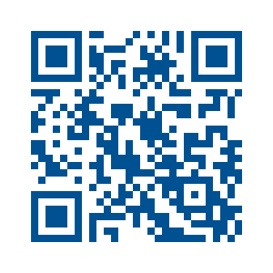
Campaign Contacts
Donate now!
Team Captains/Unit Leaders
Insert Team Captain/Unit Leaders
IU United Way Campaign Coordinator
Leah Wolfe, lcwolfe@iu.edu
IU United Way Co-Chairs
Dean David Daleke
Dean Anastasia Morrone
United Way Annual Giving & Community Impact Manager
Catherine Blankensop, catherine@monroeunitedway.org
unitedway.indiana.edu

